Slide 1


Real-Time Flood Alert System
Theme: Water Resource Management
Presented by: Mungara Gangothri Devi

Slide 2

Source: flood_inter.csv dataset
“To create a real-time flood alert system that predicts flood risks early and supports water resource management”
Learning Objectives
“To build a real-time Flood Alert System under Water Resource Management that predicts flood risks every 5 minutes and sends early alerts to save lives and resources.”
Understand the importance of water resource management in flood situations
Learn how to collect, clean, and analyze flood-related data
Apply data transformation and feature selection techniques
Build and evaluate a predictive model for real-time flood alerts
Develop a system that minimizes risks and supports decision-making
GOAL
www.freepik.com/
Source: flood_inter.csv

Slide 3


Tools and Technology used
Python – Core language for analysis, modeling, and automation
Pandas & NumPy –Efficient data handling, cleaning, and numerical computations
Matplotlib & Seaborn –Graphs, heatmaps, and pairplots for data visualization
Scikit-learn – Machine learning: preprocessing, modeling, evaluation (accuracy, confusion matrix, classification report)
Joblib –Save and load trained models and preprocessing objects for real-time predictions
Google Colab / Jupyter Notebook – Interactive environment for coding and visualization

Slide 4
Methodology
1. Data Collection → Collect real-time climate, rainfall, and water resource data from OpenWeather API and other
relevant datasets.
2. Data Cleaning → Handle missing values, remove duplicates, and standardize data for flood risk classification.
3. Exploratory Data Analysis (EDA) → Use graphs, pairplots, and heatmaps to identify patterns, correlations, and flood-prone factors.
4. Feature Selection & Transformation → Select significant features and scale them using StandardScaler for optimal model performance.
5. Model Training →Train a Logistic Regression model to classify flood risk levels.
6. Model Evaluation → Evaluate the model using accuracy, confusion matrix, and classification report.
7. Real-Time Alerts → Generate flood alerts every few seconds/minutes based on the model’s predictions.
8. Notification System →Send alerts to users via SMS or mobile notifications to ensure timely flood warnings.
9. Model Saving → Save the trained model and scaler using Joblib for future predictions without retraining.

Slide 5
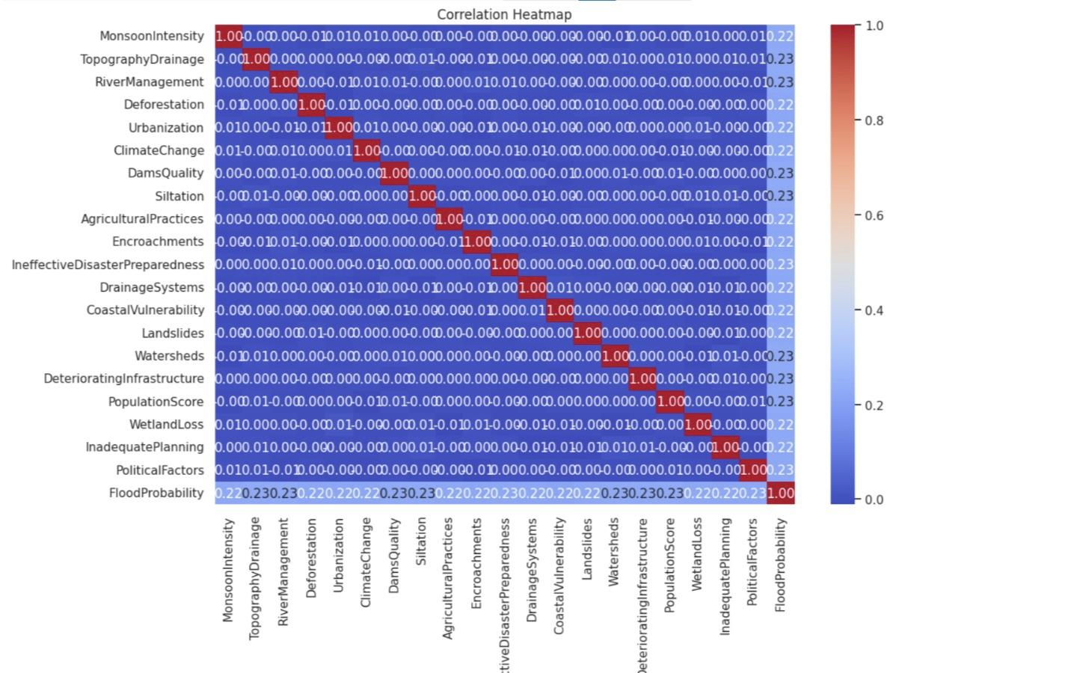
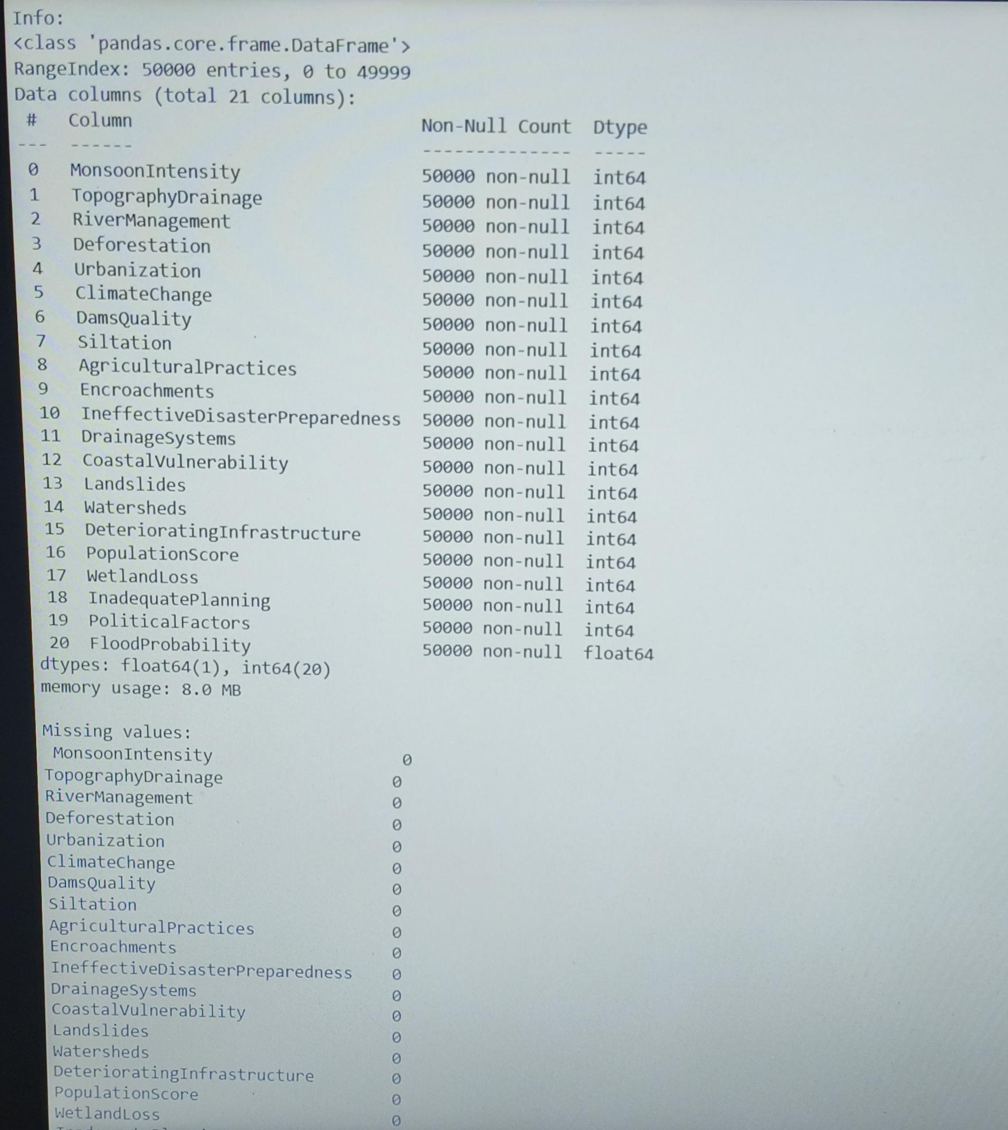
EDA Results
Correlation analysis of flood risk factors
Dataset overview & preprocessing check

Slide 6

Problem Statement:
Floods are one of the most common natural disasters, causing loss of life, crops, and property.
Floods cause huge damage to agriculture, homes, and infrastructure.
Unpredictable rainfall patterns make flood management difficult.
Delayed or no alerts leave communities unprepared
Farmers face huge agricultural losses due to unpredictable floods.
Existing monitoring methods are manual, slow, and less reliable.
Communities need a real-time, automated alert system.

Slide 7
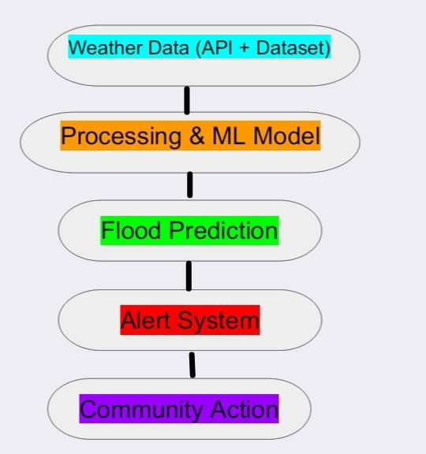

Solution:
Real time flood alert system
Use Python and machine learning to analyze water quality data.
Uses dataset + real-time weather API data for accurate monitoring
Machine Learning model predicts flood risk with high accuracy
System sends alerts: “Flood Alert” or “Safe” directly to users
Real-time notifications via SMS / Mobile alerts every few seconds/minutes
Helps governments, farmers, and communities prepare in advance
Supports Water Resource Management by reducing losses and risks

Slide 8
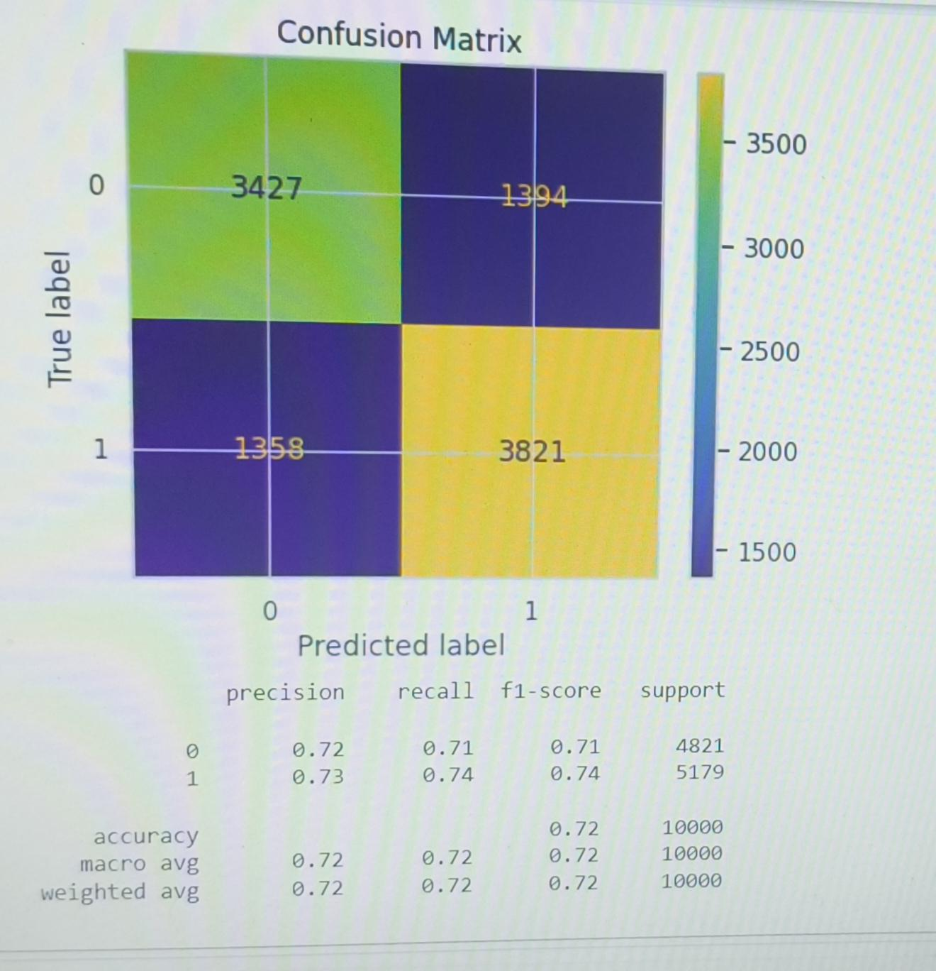
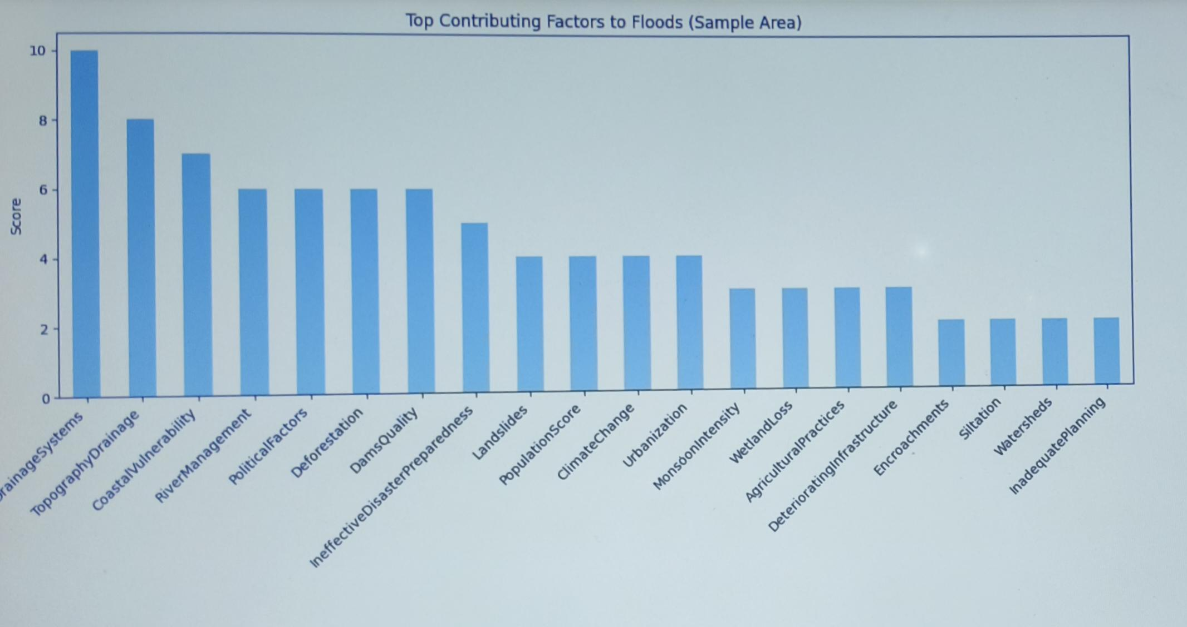
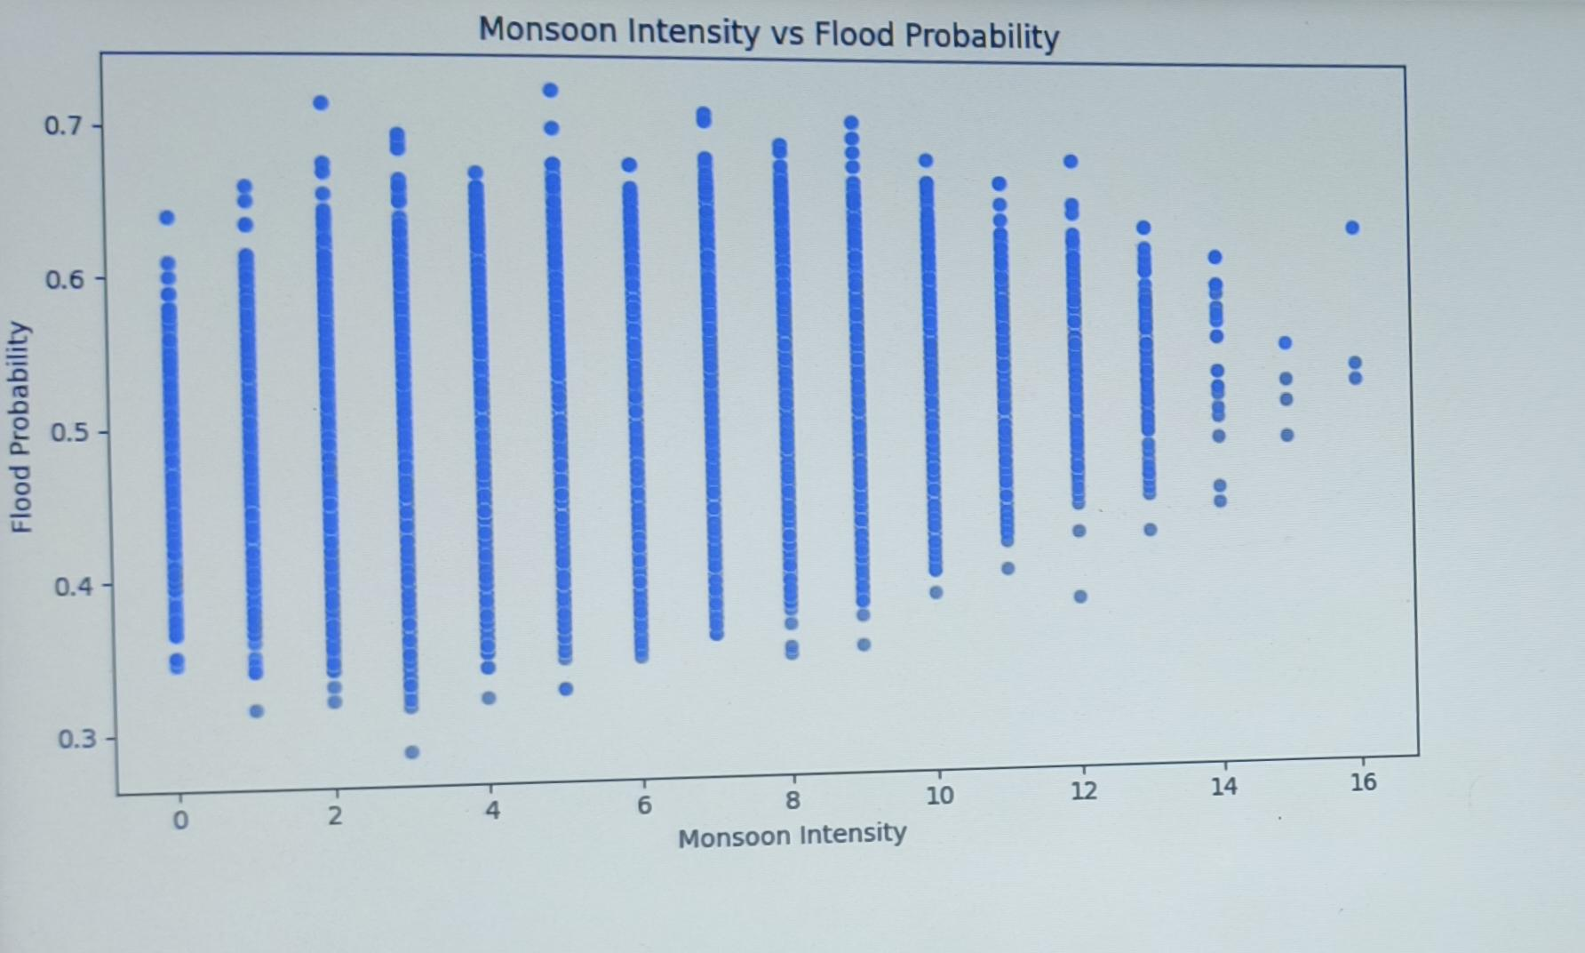
Screenshot of Output:

Slide 9
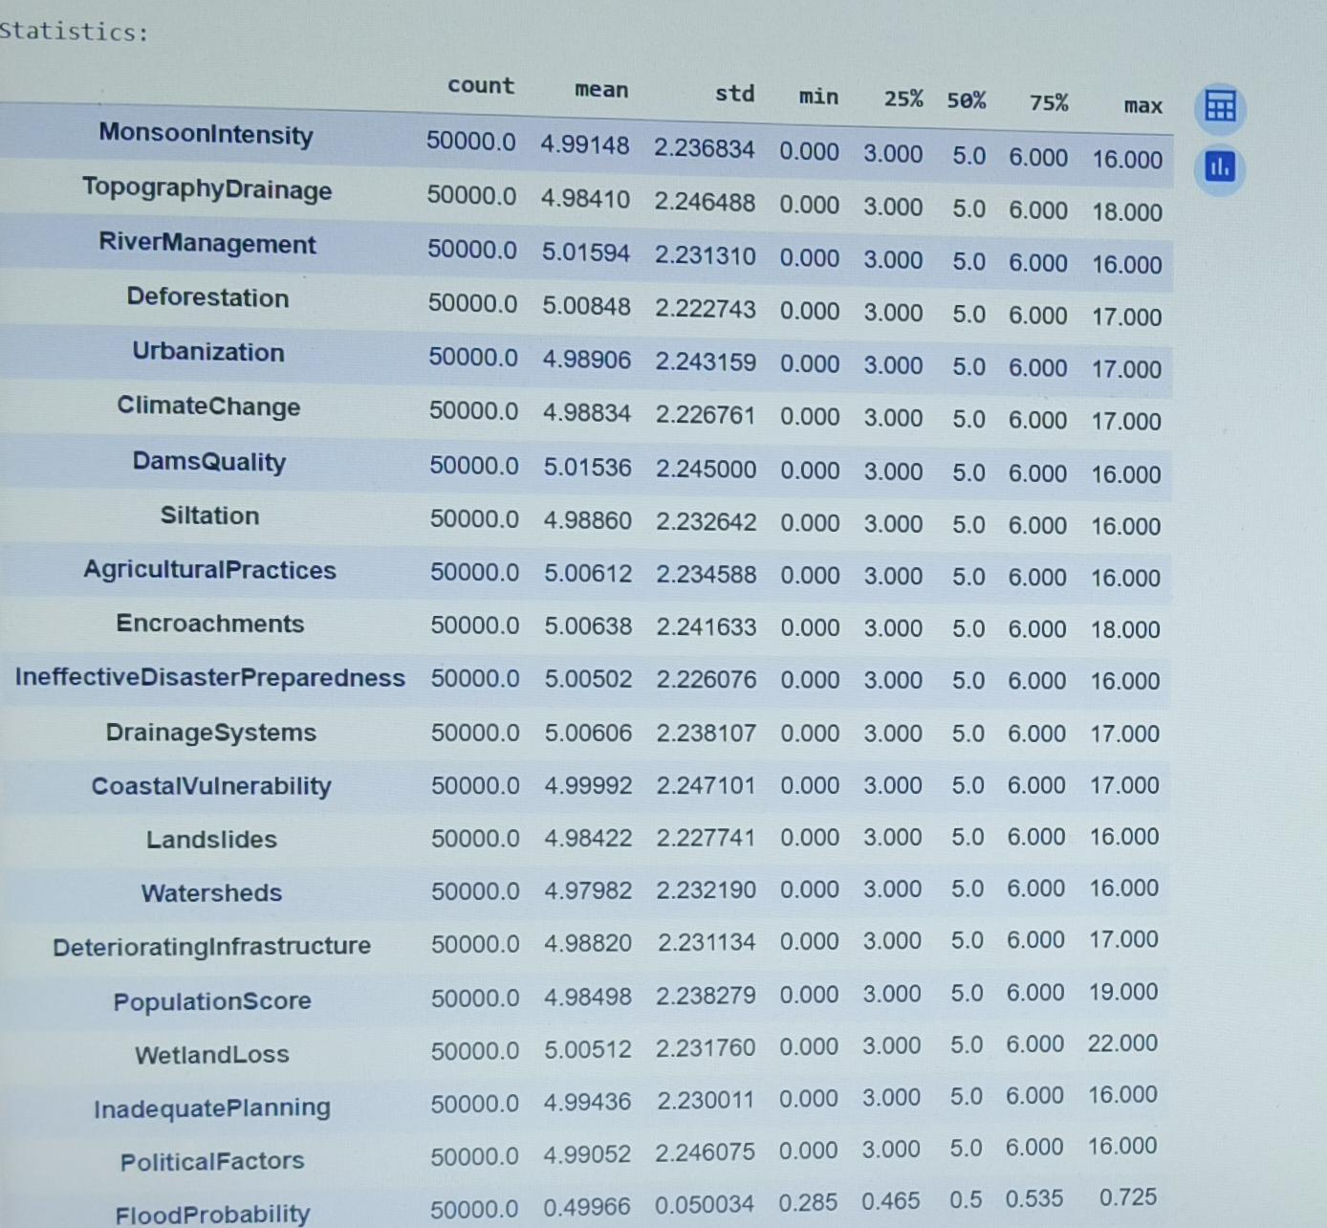
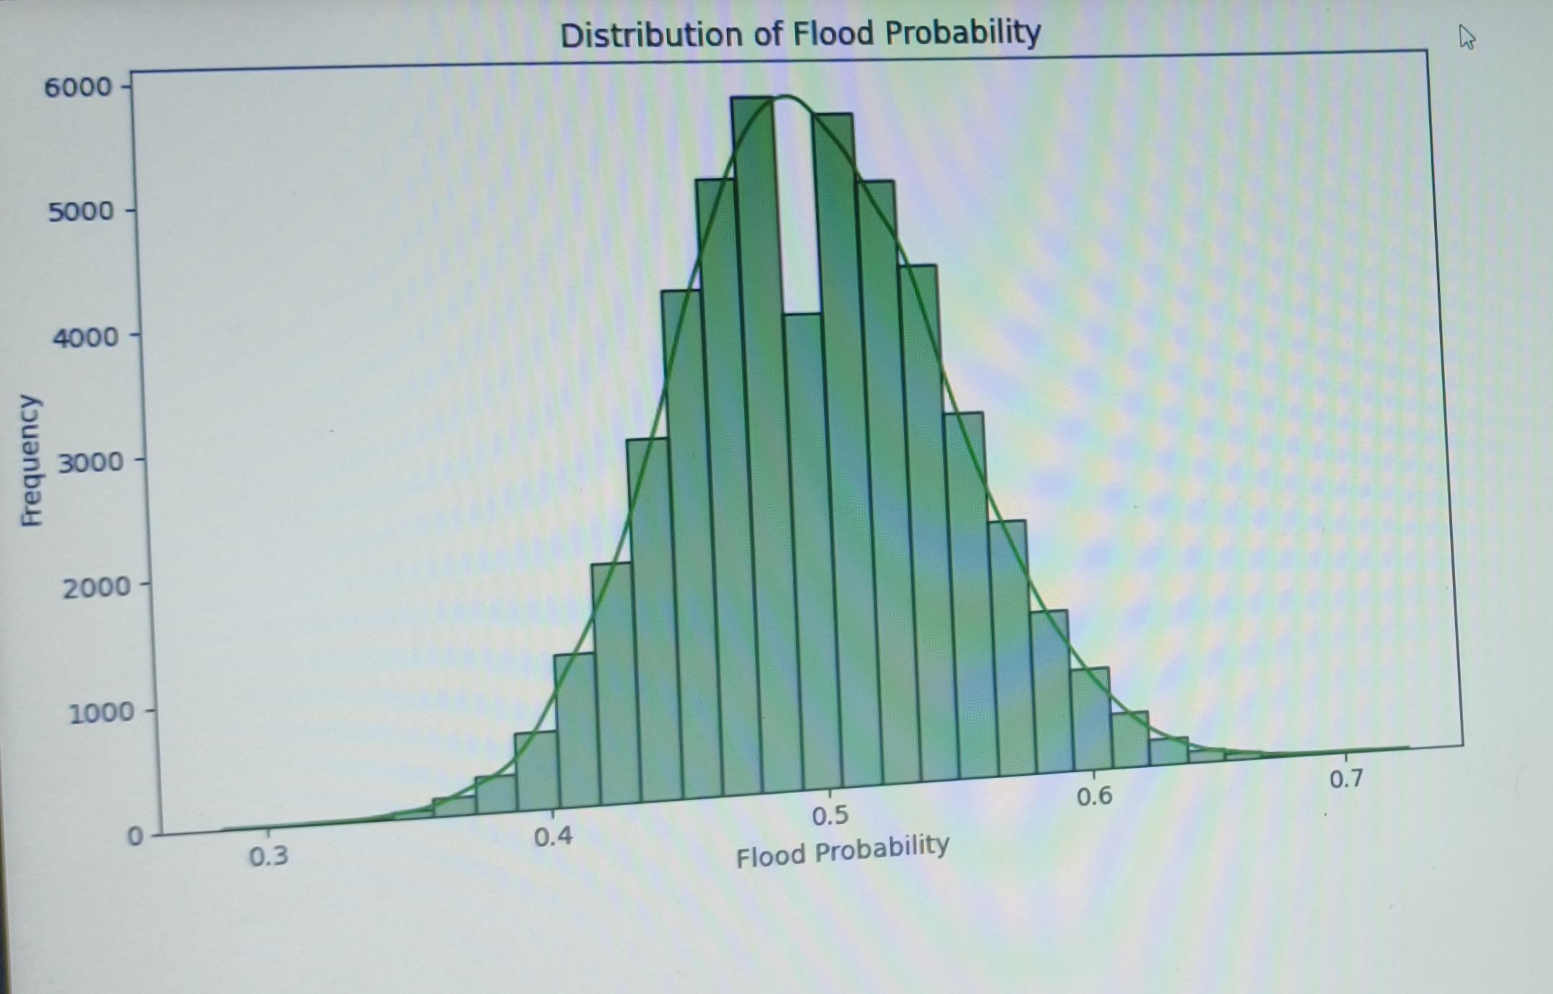
Screenshot of Output:

Slide 10
Conclusion:
Successfully developed a Real-Time Flood Alert System under Water Resource Management.
Applied EDA, data preprocessing, feature selection, and machine learning models.
Achieved reliable accuracy with the best-performing model (Random Forest / Logistic Regression).
Implemented flood alert logic that gives timely alerts (Safe / Flood Alert).
Helps farmers, communities, and authorities minimize losses and improve preparedness.
Can be extended with IoT sensors & real-time mobile apps in the future
GitHub Repository Link:
https://github.com/gangothri2706-dot/week1

